Slide 1

Project Management Process
PMP6 - v1.0

Slide 2

Our roles…
I am here as a facilitator
You are the PMP® exam candidates!

Slide 3
Objectives
What is done during each of the project management process groups
Initiating
Planning
Executing
Monitoring and Controlling
Closing
What you do not do but should do in your real world during each of the project management process groups.

Slide 4
Content
47 Processes
Type of processes
5 Process Groups
Initiating
Planning
Executing
Monitoring & Controlling
Closing
10 Knowledge Areas

Slide 5
1. 47 Processes
Notes:
- Don’t try to remember processes - Try to understand each process - Try explain it to others … It will firm your understanding

Slide 6
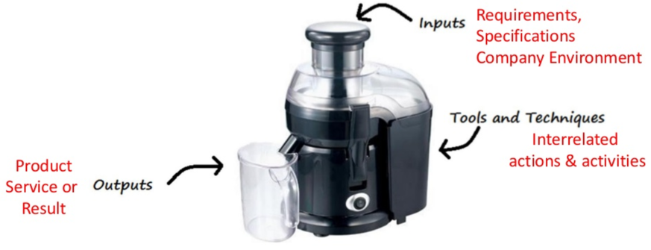
> Overview
A set of interrelated actions & activities performed to create a pre-specified product, service or result
Notes:
EEF & OPA should be taken into account as input to every process of PMI even if they are not explicitly listed in the process specifications.

Slide 7
> Overview
For project to be successful, Project team should:
Select appropriate processes as per project objective
Use defined approach that can be adapted to meet requirements
Establish & maintain communication & engagement with stakeholders
Comply with requirement to meet stakeholder needs and expectations
Balance competing constraints

Slide 8
> Type of Process
Project Management Processes
Ensure effective flow of Project throughout its life cycle Encompasses Tools & techniques involved in applying skills & capabilities
Product Oriented Processes
Specify & create projects product. Defined by product life cycle and vary by application area as well as phases of the project life cycle

Slide 9
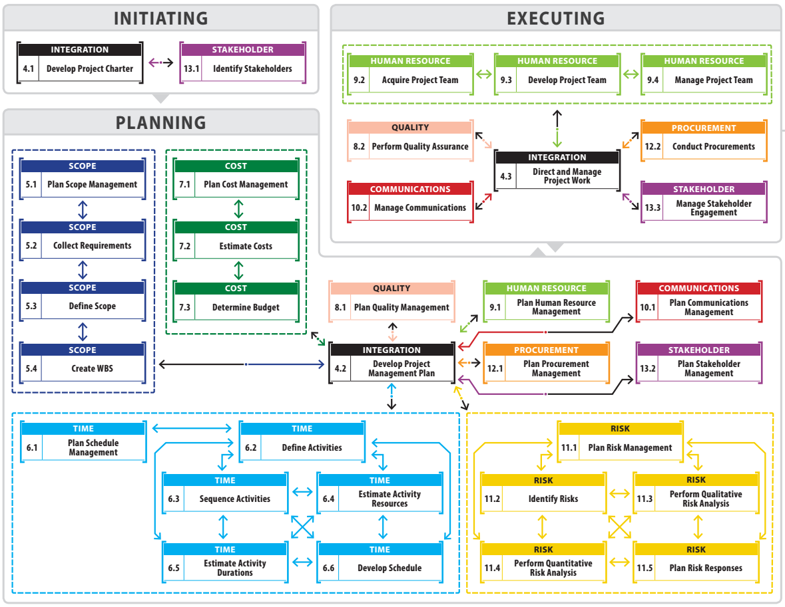
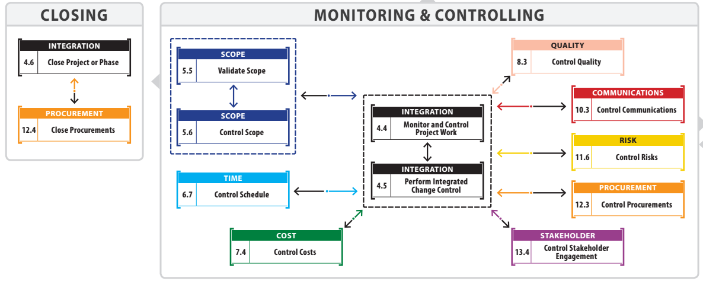
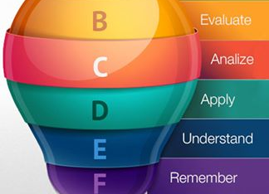
> 47 Processes of PMI
47 Processes
Notes:
47 processes must to remember for pass exam the first exam

Slide 10
2. 5 Process Groups

Slide 11
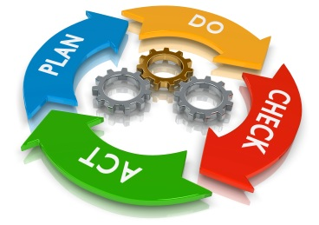
> Overview
A logical grouping of project management inputs, tools and techniques, and outputs
Initiating (Start)
Planning (Plan)
Executing (Do)
Monitoring & Controlling
(Check – Act)
Closing (Stop)
Notes:
Process group is not project phase
Initiating
Initiate new Project or Phase
Planning
Define Project Objective, Establish scope. Plan how project will be executed & closed.
Executing
Perform the work
Monitoring and Controlling
Track & review progress. Ensure compliance. Perform Integrated change management.
Closing
Finalize all project activities. Formally close phase or project.

Slide 12
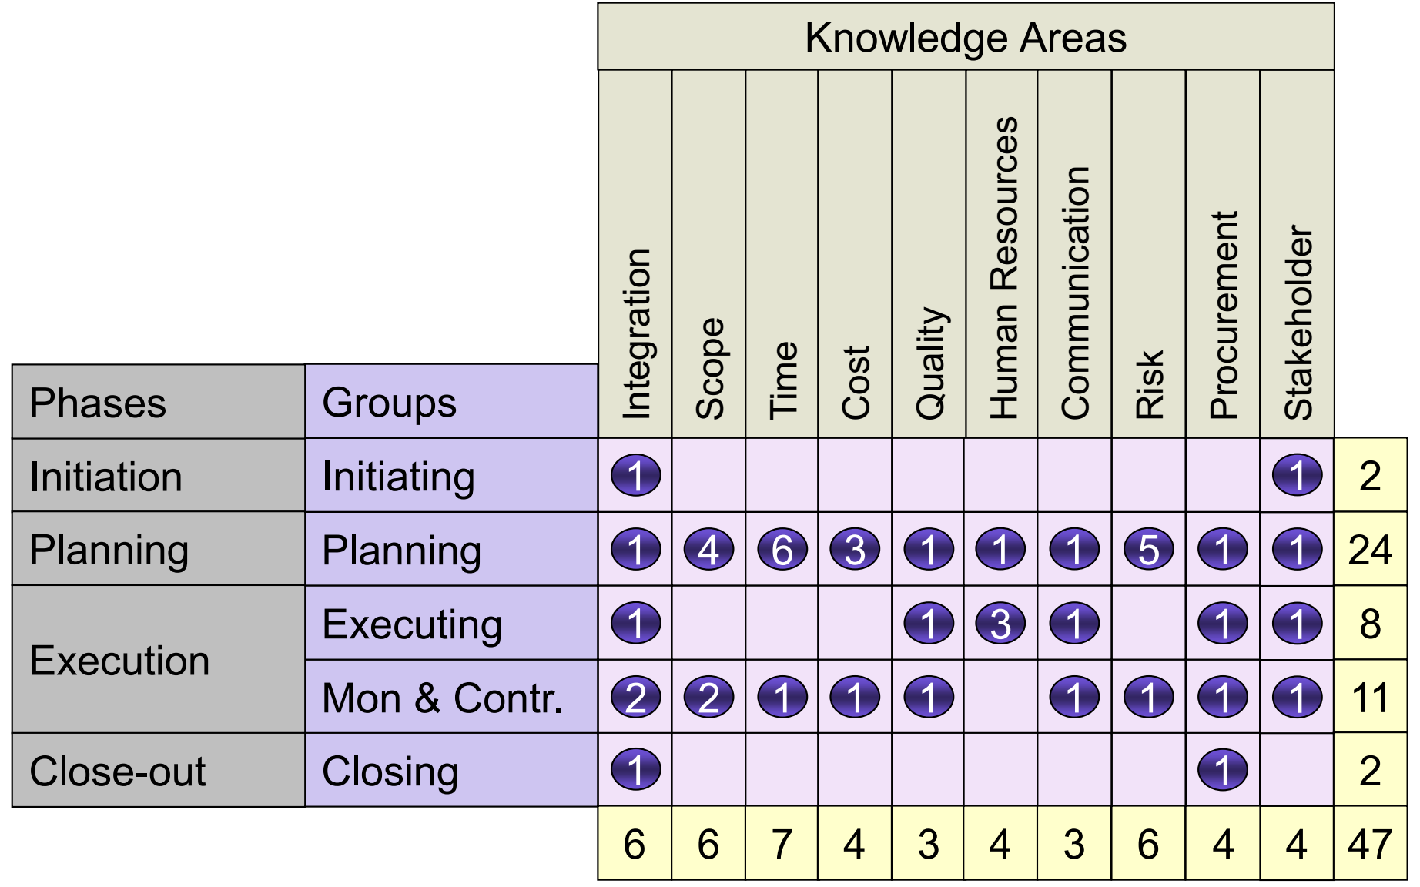

> Overview
Notes:
Initiation: 4%
Planning: 51%
Executing: 17%
Monitoring & Controlling: 24%
Closing: 4%

Slide 13
> Overview
All process groups can be conducted in a each project phase.
It is not Project life cycle Phases
Has clear dependencies
In-depended of application area or Industry focus.
Large complex projects are split into the phases.
Initiation processes carried out in each phases
Notes:
Initiation processes carried out in each phases to validate decision made in the previous phase.

Slide 14
> Initiating Process Group
It define a new project or a new phase of an existing project by obtaining authorization to start the project or phase
New Project or Project Phase
Project Manager is selected
Project charter is approved
Scope is Defined
Finance /budget is committed
Stakeholders are identified
Stakeholder expectations & understood

Slide 15
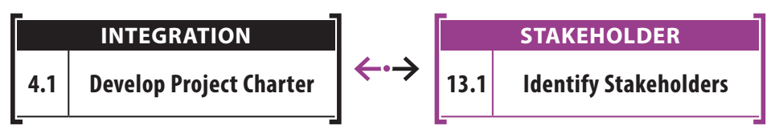
> Initiating Process Group
There are two processes in this process group.
Notes:
Explain brief for each process

Slide 16
> Initiating Process Group
Steps (follow Rita Chart)
Select project manager
Determine company culture and existing system
Collect processes, procedure and historical information
Divide large projects into phases
Understand the business case
Uncover initial requirements, assumptions, risks, constraints, and existing agreements
Assess project and product feasibility within the given constraints
Create measureable objectives
Develop project charter
Identify stakeholder and determine their expectations, influence and impact

Slide 17
> Planning Process Group
It is the place where the PM, project teams decides what they want, how to do, when to do, who to do, money needed, time needed and so on.
Establish scope
Refine objectives
Defining products to be produced
Define work required
Sequencing work (schedule)
Estimating the resource( effort) & finalize schedule
Estimating costs (budget)

Slide 18
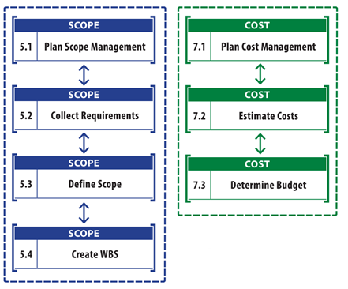
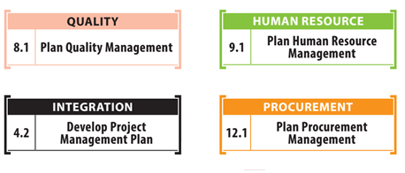
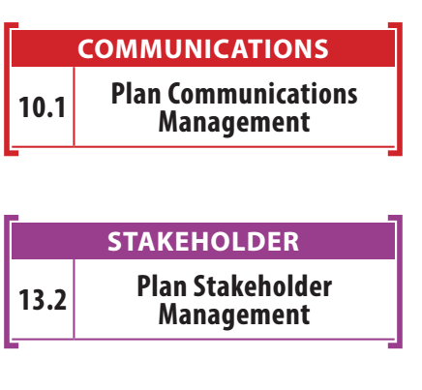
> Planning Process Group
Notes:
Explain brief for each process

Slide 19
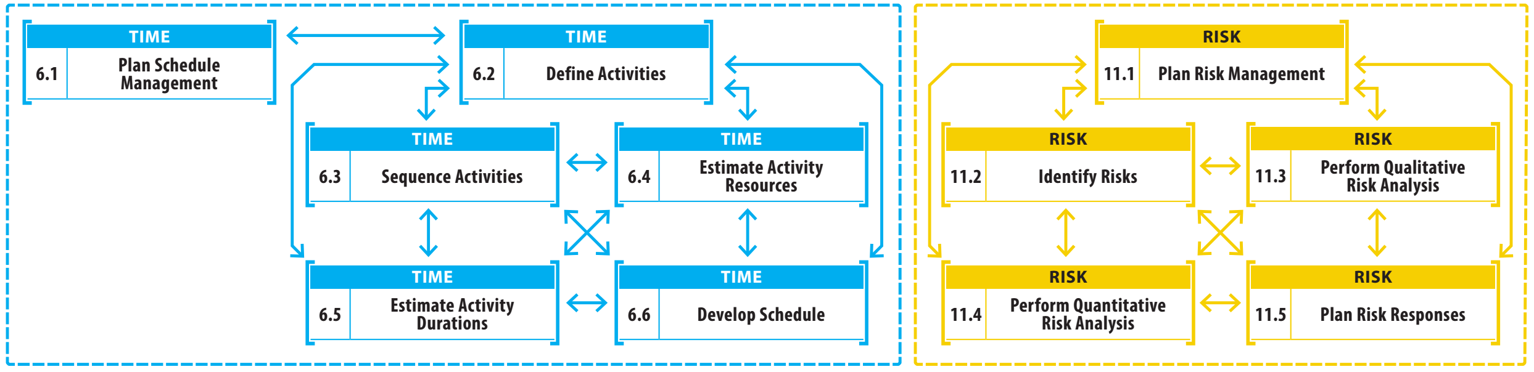
> Planning Process Group

Slide 20
> Planning Process Group

Slide 21
> Planning Process Group
Steps (follow Rita Chart)
Determine how you will plan for each knowledge area
Determine detailed requirements
Create project scope statement
Assess what to purchase and create procurement documents
Determine planning team
Create WBS and WBS Dictionary
Create activity list
Create network diagram
Estimate resource requirements
Estimate time and cost
Determine critical path
Develop schedule
Develop budget
➔ Next slide
Notes:
Map it into list of processes of planning process group.

Slide 22
> Planning Process Group
Go back - iteration
Finalize procurement documents
Create change management plan
Finalize the “how to execute and control” parts of all management plans
Develop realistic and final PM plan and performance measurement baseline
Gain formal approval of the plan
Hold kickoff meeting
Steps (follow Rita Chart)
Determine quality standards, processes and metrics
Create process improvement plan
Determine all roles and responsibilities
Plan communications and stakeholder engagement
Perform risk identification qualitative and quantitative risk analysis, risk response planning
Notes:
Map it into list of processes of planning process group.

Slide 23
> Executing Process Group
Processes performed to complete work defined in PMP to satisfy project specification.
Directing and managing project execution
Establishing and manage the project team.
Coordinating people and resources
Monitoring team performance
Procurement
Distributing information
Performing quality assurance activities

Slide 24
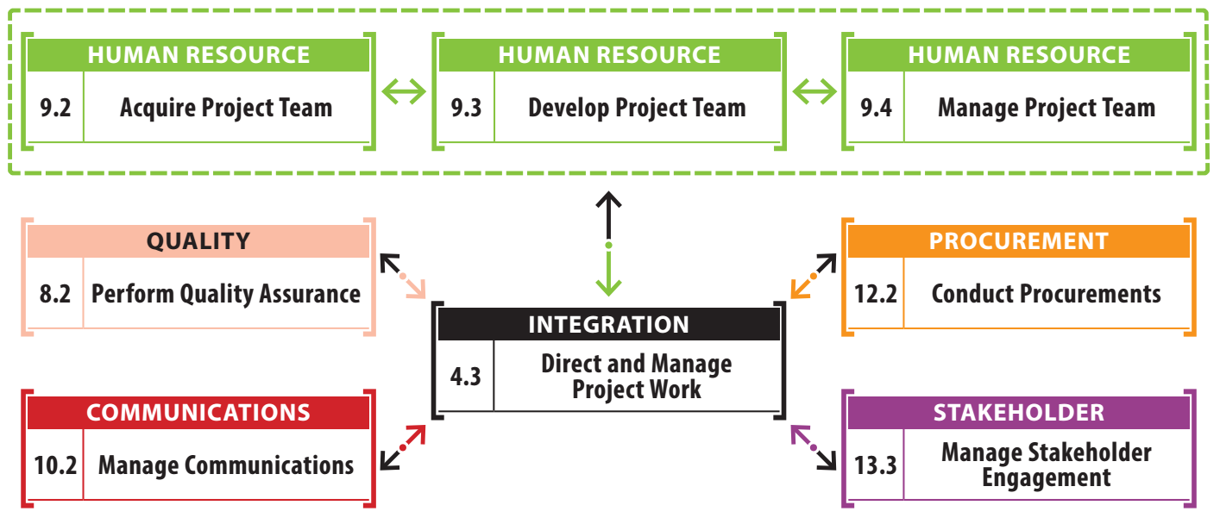
> Executing Process Group
Notes:
Explain brief for each process

Slide 25
> Executing Process Group
Steps (follow Rita Chart)
Execute the work according to the PM Plan
Produce product deliverables (product scope)
Gather work performance data
Request change
Implement only approved changes
Continuously improve
Follow processes
Determine whether processes are correct and effective (quality assurance)
Perform quality audits
Acquire final team
Manage people
Evaluate team and individual performance
Hold team building activities
➔ Next slide
Notes:
Map it into list of processes of planning process group.

Slide 26
> Executing Process Group
Steps (follow Rita Chart)
Give recognition rewards
Use issue logs
Facilitate conflict resolution
Release resource as work is completed
Send and receive information and solicit feedback
Report on project performance
Manage stakeholder engagement and expectation
Hold meetings
Select sellers
Notes:
Map it into list of processes of planning process group.

Slide 27
> Monitoring & Controlling Process Group
Those processes required to track, review, and regulate the progress and performance of the project; identify any areas in which changes to the plan are required; and initiate the corresponding changes
Involves tracking, reviewing, and regulating project progress
Includes status reporting, progress measurement, and forecasting
Reports on scope, schedule, cost, resources, quality, and risks
Controls project and project document changes
Includes control of scope, schedule, costs, and risks
Formalizes acceptance of deliverables (called scope verification)
Records quality control results

Slide 28
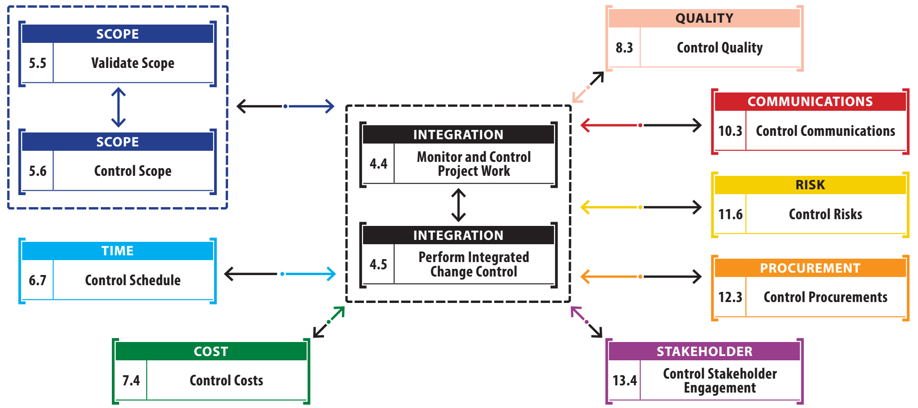
> Monitoring & Controlling Process Group
Notes:
Explain brief for each process

Slide 29
> Monitoring & Controlling Process Group
Steps (follow Rita Chart)
Take action to control the project
Measure performance against the performance measurement baseline
Measure performance against other metrics in the PM plan
Analyze and evaluate performance
Determine if variances warrant a corrective action or other change request
Influence the factors that cause changes
Request changes
Perform integrated change control
Approve or reject changes
Update the PM plan and project documents
Inform stakeholders of the results of change requests
➔ Next slide
Notes:
Map it into list of processes of planning process group.

Slide 30
> Monitoring & Controlling Process Group
Steps (follow Rita Chart)
Monitor stakeholder engagement
Manage configuration
Facilitate conflict resolution
Create forecasts
Gain acceptance of interim deliverables from the customer
Perform quality control
Perform risk reassessments and audits
Manage reserves
Control procurements
Notes:
Map it into list of processes of planning process group.

Slide 31
> Closing Process Group
Processes performed to terminate formally all activities of a project or project phase, & transfer of completed product to others or to close a cancelled project.
Obtaining acceptance by the customer or sponsor (approval to close).
Releasing people and resources.
Reporting on team performance and lessons learned
Updating or finalizing documents, project records, and results.
Close procurements.
Storing or archiving information.
Formally close project or phase

Slide 32
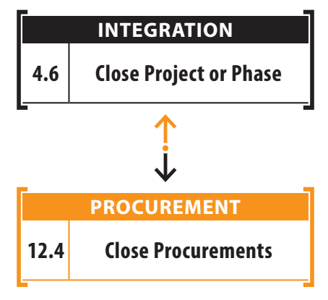
> Closing Process Group

Slide 33
> Closing Process Group
Steps (follow Rita Chart)
Confirm work is done to requirement
Complete procurement closure
Complete financial closure
Solicit feedback from customer about the project
Complete final performance reporting
Index and archive records
Gather final lesson learned and update knowledge base

Slide 34



It’s true
Don’t try to remember processes Try to understand each process Try explain it to others … It will firm your understanding

Slide 35
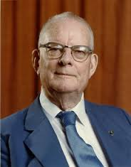
W. Edwards Deming
“If you can’t describe what you are doing as a process, you don’t know what you’re doing”

Slide 36
3. 10 Knowledge Areas

Slide 37
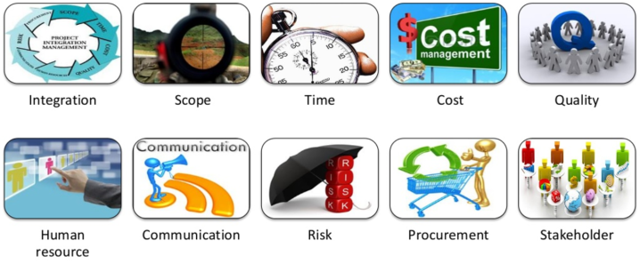
> Overview
Area of project management defined by its knowledge requirements & described in terms of its component processes, practices, inputs, outputs, tools, and techniques

Slide 38
> Overview

Slide 39
> Overview

Slide 40
Summary
What is done during each of the project management process groups
Initiating
Planning
Executing
Monitoring and Controlling
Closing
What you do not do but should do in your real world during each of the project management process groups.

Slide 41
Next Objectives
Integration management process
Integrated change control
Process for making changes
Project management plan
Project charter
Business case
Project selection
Project documents
Corrective action
Prevention action
Defect repair
Project manager’s role as integrator
Constraints and assumptions
More…

Slide 42
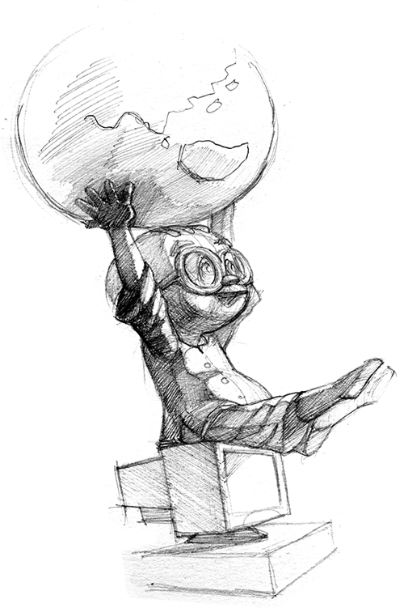
Thank you

Slide 43
Next Objectives
Configuration management system
Change control system
Change control board
Cost-benefit analysis
Kickoff meeting
Work authorization system
Project statement of work
Net present value
Internal rate of return
Payback period
Present value
Economic value added
Opportunity cost
Sunk costs
Law of diminishing returns
Working capital
Depreciation

